Slide 1

Covariance
Can be computed if joint PDF is given
Measures if RVs are “related” in some way
Also comes out naturally from variance of a sum
Can be normalized with std (corr. coeff)

Slide 2
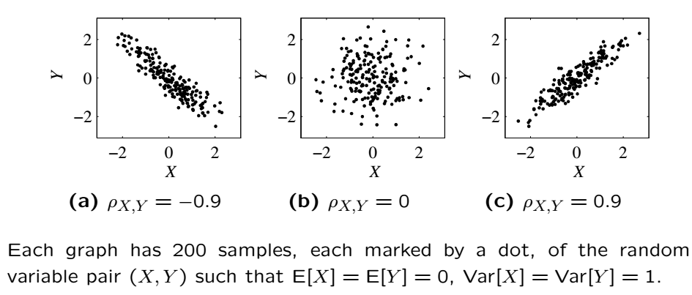
Covariance

Slide 3

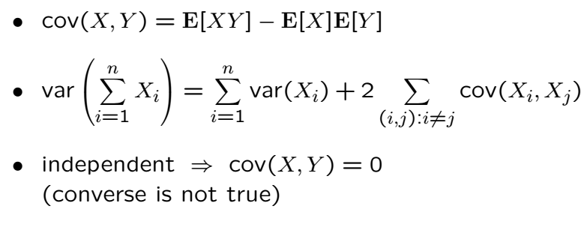
Covariance Cont’

Slide 4

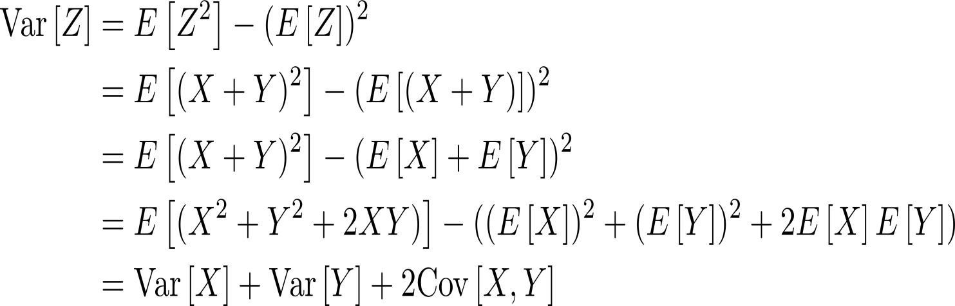
Variance of a Sum

Slide 5
Variance of a Sum Cont’
If the covariance is positive
If the covariance is negative
If the covariance is zero

Slide 6


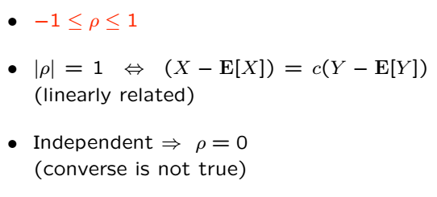
Correlation Coefficient
Dimensionless and normalized

Slide 7
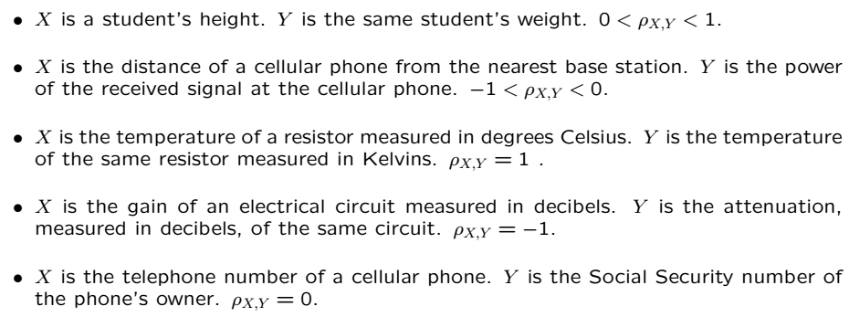
Correlation Coefficient Practical Examples

Slide 8



For Independent RVs

Slide 9





Covariance Between Gaussians
Consider:
X and Z are independent. Find where

Slide 11
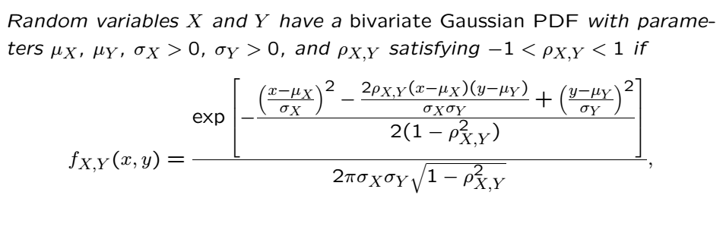
Bivariate Gaussians
Fact:

Slide 12
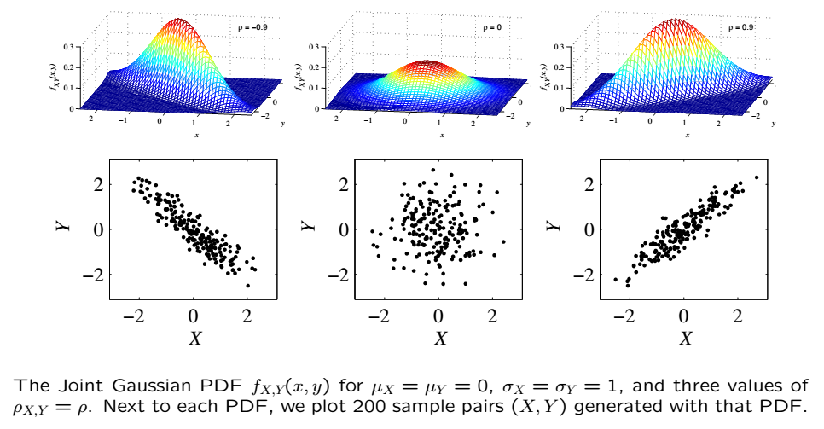
Bivariate Gaussians

Slide 13


Calculating from joint pdf
Find
Find
Find

Slide 14
Acknowledgements and Citations
Parts of these slides are adapted from the following resources:
Power Point Lecture Slides for the Textbook http://bcs.wiley.com/hebcs/Books?action=index&bcsId=8676&itemId=1118324560
John Tsitsiklis. 6.041 Probabilistic Systems Analysis and Applied Probability, Fall 2010. (Massachusetts Institute of Technology: MIT OpenCourseWare),http://ocw.mit.edu (Accessed 13 Apr, 2015). License: Creative Commons BY-NC-SA

